Slide 1
Rural Homestays and Rural Tourism
Convergence Support that can be provided by the Ministry of Rural Development

Slide 2
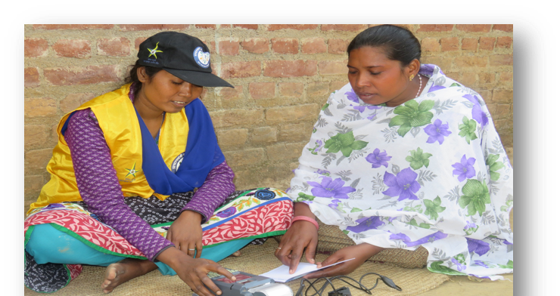
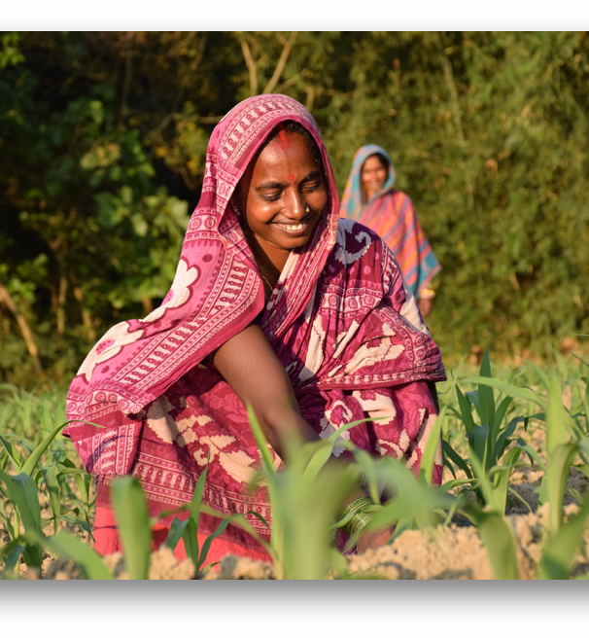
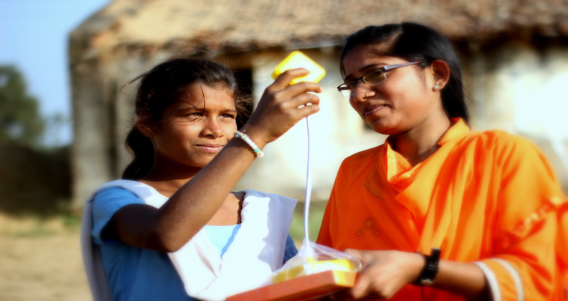
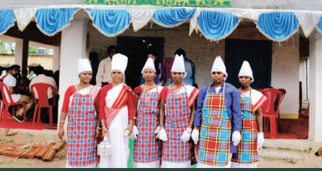
DAY-NRLM

Slide 3
DAY-NRLM
DAY-NRLM
Launched in 2011, DAY-NRLM is a centrally sponsored scheme which aims to reach out to all the rural poor in the country, organize them (into women SHGs and federations) and provide long term and continuous handholding to enable them to come out of abject poverty and move on the path to prosperity.

Slide 4
DAY-NRLM
DAY- NRLM : Key Components
Ensuring access to financial services
Diversified and Sustainable income sources
Social inclusion and Human development
Skills Development and Access to Jobs
Promotion of Sustainable institutions of the poor

Slide 5
DAY-NRLM
DAY- NRLM : Key Figures
8.95 Cr SHG members, 83 lakh SHGs
Capitalisation Support to SHGs- Rs.29,000 crores
Mahila Kisans Supported - 218 lakhs, Enterprises supported under Start-up Entrepreneurship Program(SVEP) - 2.3 lakhs
Bank linkages – Rs.6.35 Lakh crores
Coverage – 28 State &6 UTs, 7071 blocks

Slide 6
DAY-NRLM
DAY- NRLM : Rural Tourism & home stays
Initiatives by States like J&K, Assam, Sikkim, HP, Goa and Uttarakhand
Using state government funds and setting homestays in SHG members’ homes
Fledgling steps taken

Slide 7
DAY-NRLM
DAY- NRLM : Convergence opportunities
Have schemes for promoting sustainable livelihoods like SVEP and One Stop Facility (OSF) Center – For start-up enterprises
Community members may be engaged for tourism services like Guides, Porters, traditional cuisine - trainings through RSETIs
Incubator support – for supporting scale up of larger enterprises
Sectoral Clusters – For promoting rural tourism, home stays kind of enterprises
DAY-NRLM has good out reach in rural areas and CBO Eco-system

Slide 8
DAY-NRLM
DAY- NRLM : Asks – Technical Support agencies for-
Capacity building of the SRLM teams + Community members
Creation of a viable business model for rural tourism and homestays
Development of SOPs and Capacity building protocol for the rural homestays and tourism
Implementation of the Sectoral cluster on rural homestays and rural tourism
Marketing support to attract sustainable business volume

Slide 9
DAY-NRLM
DAY- NRLM : Non Negotiables and features
Enterprises are funded by loans
Enterprises have to be financially viable
Partnerships required for Capacity building, Design, and Market linkages
Individual subsidy, if needed for viability gap funding, has to be arranged from convergence
No individual Subsidy

Slide 10
Thank you
and
Questions

